Slide 1


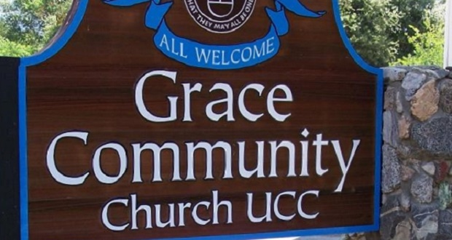






Slide 2



Slide 3

The Ten Most Misunderstood Words in the Bible

Slide 4

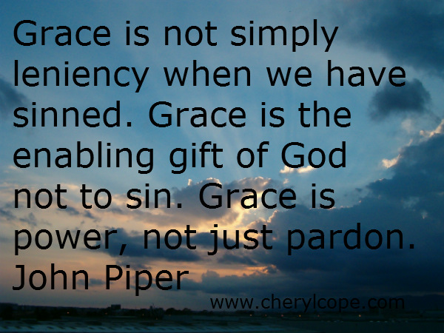
What is Grace?

Slide 5


What is Grace?

Slide 6


What is Grace?

Slide 7
Faith vs. Grace
Forgiveness
Available
Impossible
Turn
Heaven
God
Receive
All
Come
Exchange

Slide 8


What is Grace?

Slide 9

What is Grace?

Slide 10
What is Grace?
“charis” (156x’s) – “grace” “favor”, “gift”, “thanks”
“commendable”, “benefit”, “acceptable”, “pleasure”

Slide 11
What is Grace?
“charis” (156x’s) – “grace” The most common use of the word is “favor”,
not “unmerited favor”.

Slide 12
Favored Grace
“Then the angel said to her, ‘Do not be afraid, Mary, for you have found favor with God.” (Luke 1:30)
Not a arbitrary choice, but based on Mary’s godly character.

Slide 13
Favored Grace
“And Jesus increased in wisdom and stature, and in favor with God and men.” (Luke 2:52)
His favor with God was deserved and was not unmerited.

Slide 14
Favored Grace
The early church was, “breaking bread from house to house, they ate their food with gladness and simplicity of heart, praising God and having favor with all the people.” (Acts 2:47)
They were held in high regard.

Slide 15
Grace as a Gift
“Moreover, brethren, we make known to you the grace/gift of God bestowed on the churches of Macedonia…” (2 Cor. 8:1)
“charis” used 10x’s in two chapters primarily meaning “gift”

Slide 16
Grace as a Gift
“… imploring us with much urgency that we would receive the gift and the fellowship of the ministering to the saints.” (2 Cor. 8:4)
The “gift” was for the collection of the poor saints in Jerusalem

Slide 17
Grace as a Gift
“…so he would also complete this grace in you as well… see that you abound in this grace also.” (2 Cor. 8:6-7)
God’s grace/gift is what makes the Macedonian’s and the Corinthian’s gifts possible.

Slide 18
Grace as a Gift
“…so he would also complete your share in this ministry of giving… see that you abound in this act of grace also.” (2 Cor. 8:6-7) [NLB]
God’s grace/gift is what makes the Macedonian’s and the Corinthian’s gifts possible.

Slide 19
Grace as a Gift
“abound in this grace also.” [NKJV] “this grace of giving” [NIV]
“this gracious act of giving” [NLB]
“this grace of liberal giving also” [WNT]
Paul wants the Corinthians to “abound in this gift also”

Slide 20
Grace as a Gift
“For you know the grace/gift of our Lord Jesus Christ, that though He was rich, yet for your sakes He became poor, that you through His poverty might become spiritually rich.” (2 Cor. 8:9)
The gift of the Incarnation

Slide 21
Grace as a Gift
“For you know the grace/gift of our Lord Jesus Christ…”
Paul uses Jesus’ gift of the incarnation to spur the Corinthians to complete their gift to the churches in Judea.

Slide 22
Grace as Thanksgiving
“…because of the exceeding grace/gift of God in you. Thanks be to God for His indescribable gift!” (2 Cor. 9:14-15, 8:16)
Our thanks to God is due to His grace or His favor which He has shown us.

Slide 23
Grace as Commendable
“For this is commendable, if because of conscience toward God one endures grief, suffering wrongfully… But when you do good and suffer, if you take it patiently, this is commendable before God!” (1 Peter 2:19-20)
“praiseworthy” or “admirable”

Slide 24
Grace in the Gospels
“charis” occurs just 11x’s in the four Gospels.
“charis” 7x’s in Luke and 4x’s in John (Only in the prolong) Their use means “thanks or credit”, not “grace or gift”

Slide 25
Fallen from Grace
“…you who attempt to be justified by law; you have fallen from grace.” (Gal. 5:4)
This does not mean they lost their salvation.

Slide 26
Fallen from Grace
“…you who attempt to be justified by law; you have fallen from grace.” (Gal. 5:4)
It means that they lost the present experience of God’s favor when they turned back to the Law. They fell under God displeasure.

Slide 27
Salvation by Grace
“For by grace/favor you have been saved through faith, and that not of yourselves; it is the gift of God, not of works, lest anyone should boast.” (Ephesians 2:8-9)
God’s “favor” or “goodwill”

Slide 28
Salvation by Grace
“But God, who is rich in mercy, because of His great love with which He loved us…” (Eph. 2:4)
“For God so loved the world…”
(John 3:16a)
Context

Slide 29
Salvation by Grace
“even when we were dead in trespasses,”
(Eph. 2:5a)
“while we were yet sinners…”
(Romans 5:8)
Context

Slide 30
Salvation by Grace
“made us alive together with Christ (by grace you have been saved).” (Ephesians 2:5b)
“that whoever believes in Him should not perish but have everlasting life.”
(John 3:16b)
“made alive” = Salvation

Slide 31
Salvation by Grace
So God did favor us by bringing us the message that they might believe it and be made alive; saved.
“by-favor-through-faith-salvation”
“it is the gift of God”

Slide 32
Salvation through Faith
“So then faith comes by hearing, and hearing by the word of God.” (Rom 10:17)
Saved though believing the Word which was heard.
But how was it heard? (10:13)

Slide 33
Salvation by Grace
We are saved by calling on the LORD, through believing the Word which we heard from the preacher that was sent from God, who by His grace/favor was sent to preach the good news. (10:13-15)

Slide 34
Salvation by Grace
“Now to him who works, the wages are not counted as grace but as debt.” (Romans 4:4)
The gift of eternal life is never merited or earned. Good works are not counted toward salvation.

Slide 35
Salvation by Grace
“And if by grace, then it is no longer of works; otherwise grace is no longer grace.” (Romans 11:6)
Grace is a used in the sense of a gift or unmerited favor in contrast to wages.

Slide 36
Salvation by Grace
But the favor that results in the message being proclaimed is some-times given in response to the actions or attitudes of unbelievers.
Case Under Review: Cornelius

Slide 37
Salvation by Grace
Peter said to Cornelius and his Gentile household, “But in every nation whoever fears Him and works righteousness is accepted by Him.” (Acts 10:35)
In some cases God acts favorably by bringing the message of life to people.

Slide 38
Salvation by Grace
Peter said to Cornelius and his Gentile household, “But in every nation whoever fears Him and works righteousness is accepted by Him.” (Acts 10:35)
God’s grace is not arbitrary, not apart from our attitudes and actions.

Slide 39
Salvation by Grace
Under Calvinism [Dortism], or Reformed Doctrine God arbitrarily, [that is randomly or for some uniformed reason know to man], causes a given person to be born again.

Slide 40
Salvation by Grace
Under Calvinism [Dortism], or Reformed Doctrine man is totally unable to do anything, including believing in Jesus for eternal life. He must first be regenerated [made alive] before he can believe.

Slide 41
Salvation by Grace
Under Calvinism [Dortism], or Reformed Doctrine there is absolutely nothing an unregenerate person can do that moves God to bring him the message of life.
Method-less Evangelism

Slide 42
Salvation by Grace
Under Arminianism or Methodism God favor is unmerited, but eternal life is earned. Salvation requires constant diligence and hard work.
Methodism Evangelism

Slide 43
Salvation by Grace
How to Evangelism
Calvinism – Man can do nothing, its all up to God.
Arminianism - God can do nothing, It’s all up to Man.

Slide 44
Salvation by Grace
Under the Free Grace perspective an unregenerate person can pray, give, love, humble himself, attend church, all activities that lead God to bring him the message of eternal life.
Free Evangelism

Slide 45
Salvation by Grace
The reason God showed favor and sent an angel to Cornelius is because of his prayers and his alms giving (Acts 10:4-5).
Case Under Review: Cornelius

Slide 46
Salvation by Grace
Cornelius heard the saving message and believed because of his prayers and his alms giving – but these were not works in order to earn eternal life.
Case Under Review: Cornelius

Slide 47
Salvation by Grace
The unbeliever can seek God and his seeking can move God to bring him the message he needs to hear and believe to be born again.
Eternal life is not given in response to an unbeliever’s actions and attitudes.

Slide 48
Salvation by Grace
“There is none who seeks after God.” (Romans 3:11)
Man left to his own initiative, apart from God’s drawing no one seeks God. But since God is drawing all men, then all men are free to seek God in response.

Slide 49
Salvation by Grace
Implications
Unbelievers can do things to aid themselves in hearing or believing the message of Life. They can pray, study, and ask God to show them the way. They can repent of sins.

Slide 50
Salvation by Grace
Implications
We can honestly share our own testimony about how we came to faith in Christ - the prayers, the longings for God, the churches we visited, and the message we heard.

Slide 51
Salvation by Grace
Implications
We can be strengthened by the good things that happened in our lives as a result of good works we have done.

Slide 52
Salvation by Grace
Implications
God’s Word says, God blesses obedience and curses disobedience (Heb. 6:4-8) “Whatever a man sows, that he will reap.” (Gal. 6:7)

Slide 53
Salvation by Grace
Implications
In one sense any divine favor or blessing from God to sinful humans is undeserved. We all fall short.
In another sense God’s favor to sinful humans may at times be deserved.

Slide 54
Salvation by Grace
Implications
God has promised to bless us, show us favor, if we do certain things or have certain attitudes that please Him. God has obligated Himself to bless us if we please Him.

Slide 55
Salvation by Grace
Implications
God’s grace then is not always arbitrary or undeserved. And since God blesses those who obey Him, this should motivate us to work even harder for God.

Slide 56
Amazing Grace
Conclusion

Slide 57
Amazing Grace
Give thanks to God for His Grace
Know that God’s favor and blessings on our daily lives are crucial.
Know that when our actions and attitudes please God, His favor is guaranteed to follow.

